Slide 1
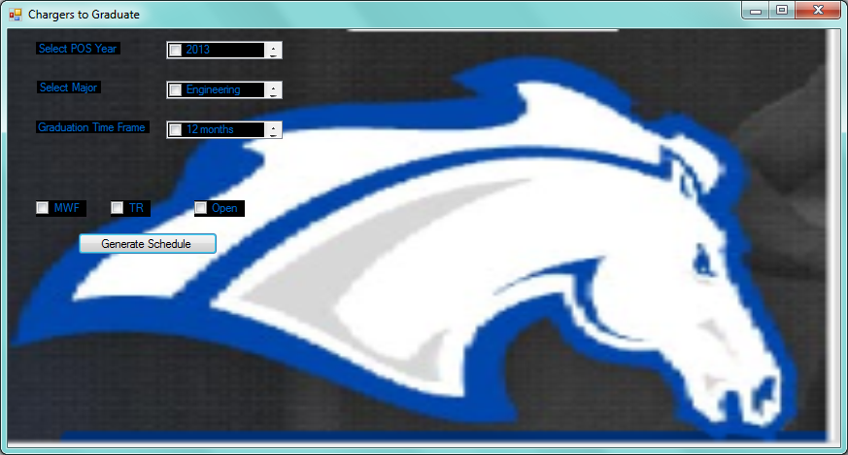
Design Suggestion 1....

Slide 2
Configure Student Options
Select school year to pull correct POS
Select major, what degree does the student want to pursue
Graduation time frame, when does the student want to graduate
Hours per semester, how many hours does the student want to take each semester
What are the students days of availability

Slide 3
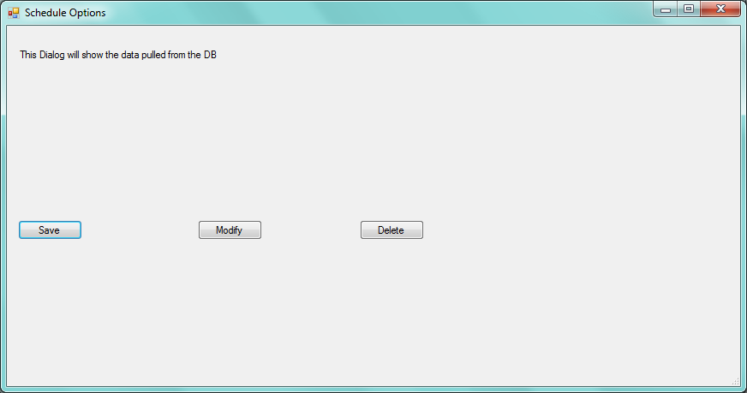
Once Options are Selected

Slide 4
Description of Last Screen
User should be able to Save, Modify, or Delete an option
If everything is likable they could save and send to the Advisor for Review
GUI needs to have Help option

Slide 5
Explanation of Previous Slide
The student would select a class from the options that were populated
Once they are done selecting the class options, then a schedule should be “generated”, based on those set of options
So basically it would be a 3-level drill down for right now
Help and other options could be added later

Slide 6
Questions
Let me know what you guys think.
I will be back in town on Tuesday.
Thanks, Natalie

